Slide 1
Probability Distribution (3)
Md. Ismail Hossain Riday

Slide 2
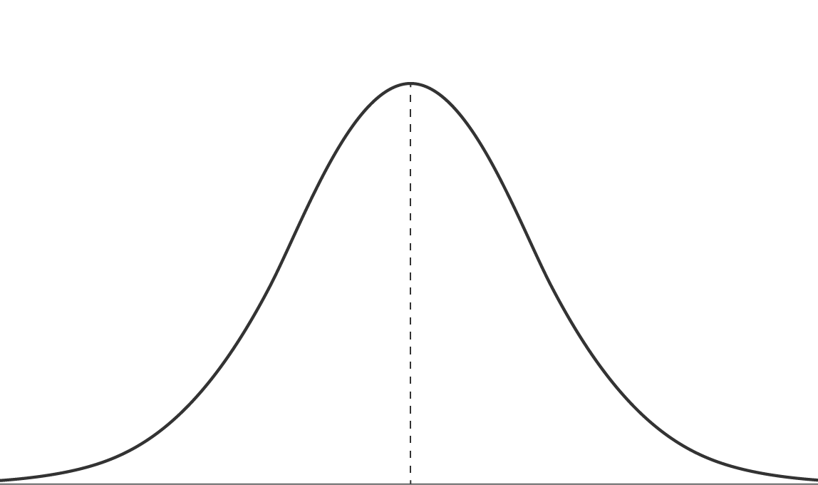
Normal Distribution
Normal distribution is a probability distribution that is symmetric about the mean
Also known as the Gaussian distribution

Slide 3
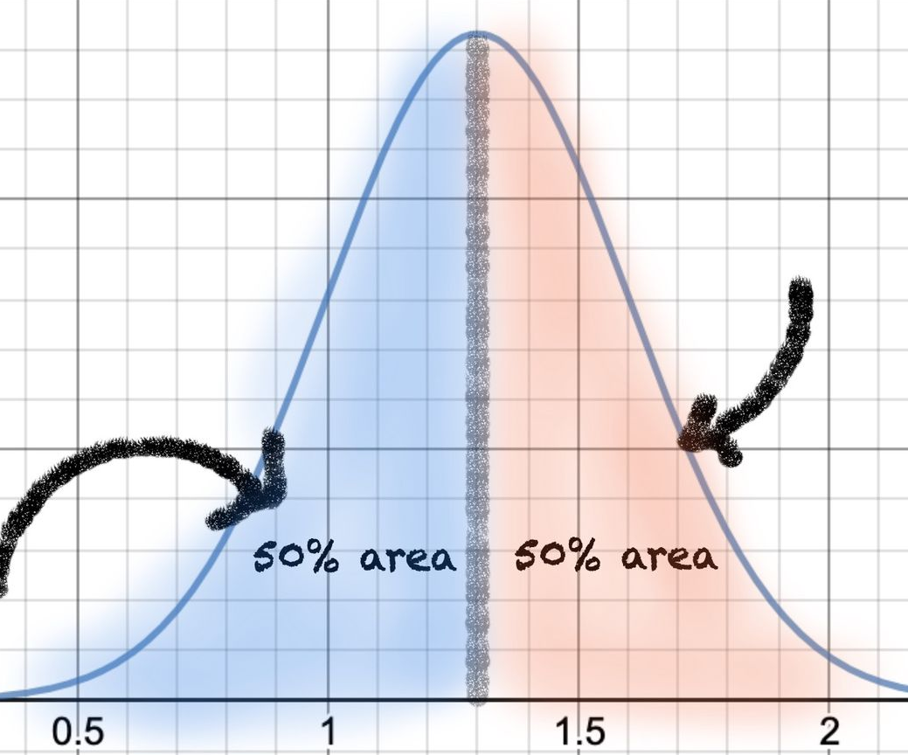
Properties Normal Distribution
Mean is the middle value and divides the area in half
Mean = Median = Mode
Symmetric and Mesokurtic
Bell-shaped curve

Slide 4
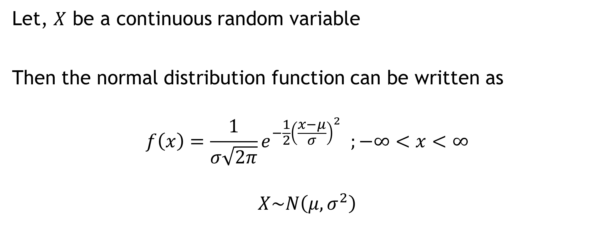
Normal Distribution
Let, $X$ be a continuous random variable
Then the normal distribution function can be written as
$$f\left(x\right)=\frac{1}{σ\sqrt{2π}}e^{−\frac{1}{2}{\left(\frac{x−μ}{σ}\right)}^{2}} ;−∞<x<∞$$
$$X\sim N\left(μ,σ^{2}\right)$$

Slide 5

Normal Distribution
Mean of normal distribution, $E\left(X\right)=μ$
Variance of normal distribution, $V\left(X\right)=σ^{2}$

Slide 6


Standard Normal Distribution
Let, $Z=\frac{X−μ}{σ}$
$$f\left(z\right)=\frac{1}{\sqrt{2π}}e^{−\frac{1}{2}z^{2}} ;−∞<z<∞$$
Mean, $E\left(Z\right)=E\left(\frac{X−μ}{σ}\right)=\frac{E\left(X\right)−μ}{σ}=\frac{μ−μ}{σ}=0$
Variance, $V\left(Z\right)=V\left(\frac{X−μ}{σ}\right)=\frac{V\left(X\right)}{σ^{2}}=\frac{σ^{2}}{σ^{2}}=1$
$$Z\sim N(0,1)$$

Slide 7
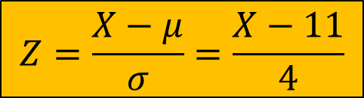
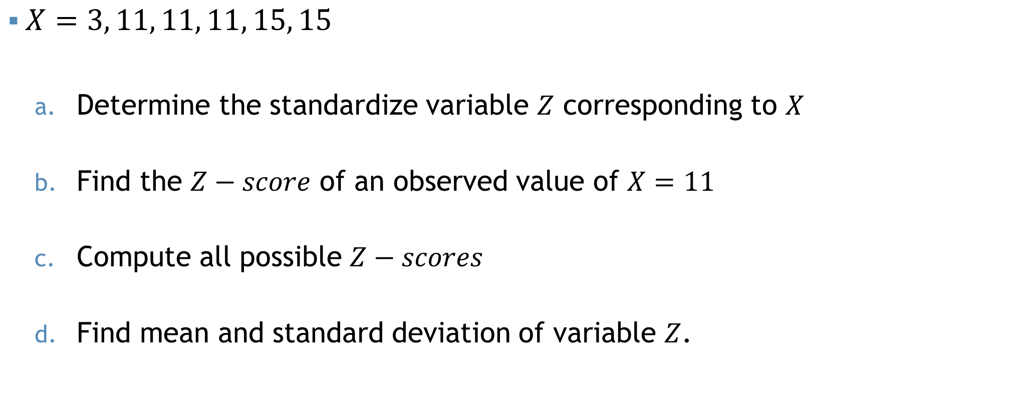
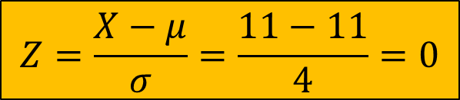
Standard Normal Distribution
$X=3, 11, 11, 11, 15, 15$
Determine the standardize variable $Z$ corresponding to $X$
Find the $Z−score$ of an observed value of $X=11$
Compute all possible $Z−scores$
Find mean and standard deviation of variable $Z$.
$$Z=\frac{X−μ}{σ}=\frac{X−11}{4}$$
$$Z=\frac{X−μ}{σ}=\frac{11−11}{4}=0$$

Slide 8
Probability Calculation
There are two methods to compute the probabilities associated with a normal variable:
Using Table (Z table)
Using Calculator

Slide 9

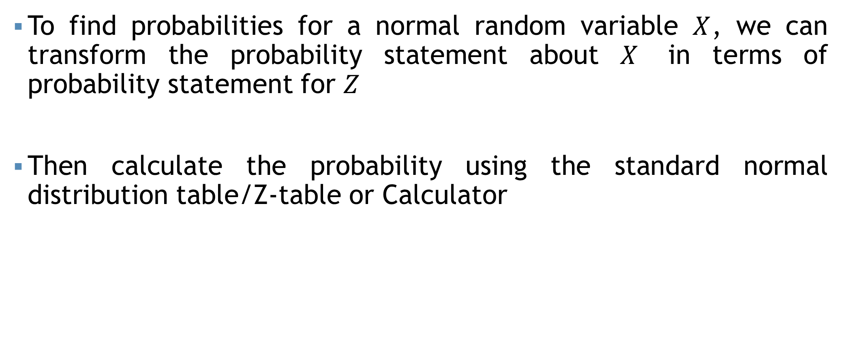


Steps
$$X$$
$$Z$$
$Z=\frac{X−μ}{σ}$
To find probabilities for a normal random variable $X$, we can transform the probability statement about $X$ in terms of probability statement for $Z$
Then calculate the probability using the standard normal distribution table/Z-table or Calculator

Slide 10
Example
The number of viewers of a TV show per week has a mean of 29 million with a standard deviation of 5 million. Assume that, the number of viewers of that show follows a normal distribution.
What is the probability that, next week’s show will-
Have between 30 and 34 million viewers?
Have at least 23 million viewers?
Exceed 40 million viewers?

Slide 11


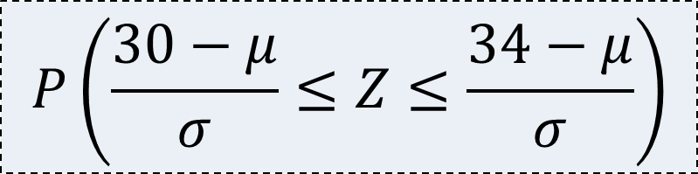




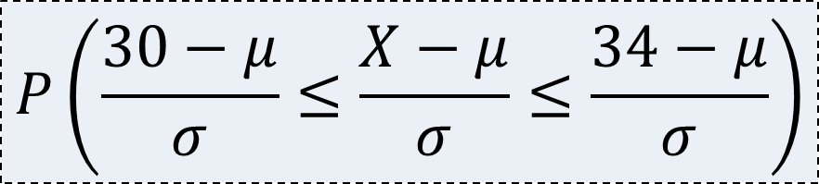



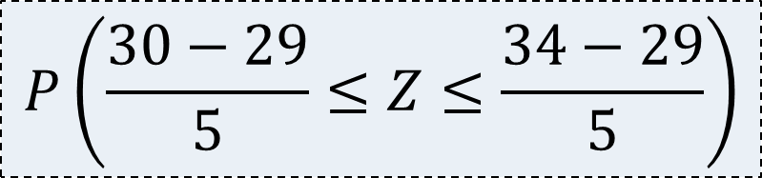

Example
Transform the probability statement in terms of $Z$
$$Z=\left(\frac{X−μ}{σ}\right)$$
Let, $X$= Number of viewers of the show per week (in million)
Here, $X\sim N\left(μ, σ^{2}\right)$; i.e., $X\sim N\left(29, 25\right)$
a. Have between 30 and 34 million viewers?
$$P\left(\frac{30−μ}{σ}≤\frac{X−μ}{σ}≤\frac{34−μ}{σ}\right)$$
$$P\left(\frac{30−μ}{σ}≤Z≤\frac{34−μ}{σ}\right)$$
$$P(30≤X≤34)$$
$$P\left(a≤X≤b\right)$$
$$P\left(b\right)−P(a)$$
$$P\left(a<X<b\right)$$
$$P\left(\frac{30−29}{5}≤Z≤\frac{34−29}{5}\right)$$
$$???−???$$
$$P\left(1\right)−P(0.2)$$
$$P\left(0.2≤Z≤1\right)$$

Slide 12
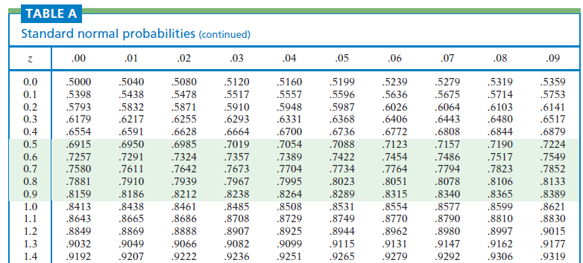
Z table

Slide 13
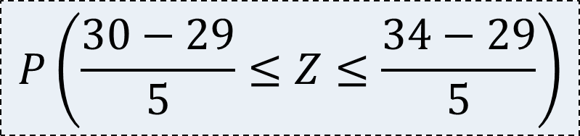

Example
Transform the probability statement in terms of $Z$
$$Z=\left(\frac{X−μ}{σ}\right)$$
Let, $X$= Number of viewers of the show per week (in million)
Here, $X\sim N\left(μ,σ^{2}\right)$
a. Have between 30 and 34 million viewers?
$$P\left(\frac{30−μ}{σ}≤\frac{X−μ}{σ}≤\frac{34−μ}{σ}\right)$$
$$P\left(\frac{30−μ}{σ}≤Z≤\frac{34−μ}{σ}\right)$$
$$P(30≤X≤34)$$
$$P\left(\frac{30−29}{5}≤Z≤\frac{34−29}{5}\right)$$
$$P\left(\frac{30−29}{5}≤Z≤\frac{34−29}{5}\right)$$
$$???−???$$
$$P\left(1\right)−P(0.2)$$
$$P\left(0.2≤Z≤1\right)$$

Slide 14

Example
Transform the probability statement in terms of $Z$
$$Z=\left(\frac{X−μ}{σ}\right)$$
Let, $X$= Number of viewers of the show per week (in million)
Here, $X\sim N\left(μ,σ^{2}\right)$
a. Have between 30 and 34 million viewers?
$$P\left(\frac{30−μ}{σ}≤\frac{X−μ}{σ}≤\frac{34−μ}{σ}\right)$$
$$P\left(\frac{30−μ}{σ}≤Z≤\frac{34−μ}{σ}\right)$$
$$P(30≤X≤34)$$
$$P\left(\frac{30−29}{5}≤Z≤\frac{34−29}{5}\right)$$
$$P\left(\frac{30−29}{5}≤Z≤\frac{34−29}{5}\right)$$
$$0.8431−???$$
$$P\left(1\right)−P(0.2)$$
$$P\left(0.2≤Z≤1\right)$$

Slide 15


Example
Transform the probability statement in terms of $Z$
$$Z=\left(\frac{X−μ}{σ}\right)$$
Let, $X$= Number of viewers of the show per week (in million)
Here, $X\sim N\left(μ,σ^{2}\right)$
a. Have between 30 and 34 million viewers?
$$P\left(\frac{30−μ}{σ}≤\frac{X−μ}{σ}≤\frac{34−μ}{σ}\right)$$
$$P\left(\frac{30−μ}{σ}≤Z≤\frac{34−μ}{σ}\right)$$
$$P(30≤X≤34)$$
$$P\left(\frac{30−29}{5}≤Z≤\frac{34−29}{5}\right)$$
$$P\left(\frac{30−29}{5}≤Z≤\frac{34−29}{5}\right)$$
$$0.8431−0.5793$$
$$P\left(1\right)−P(0.2)$$
$$P\left(0.2≤Z≤1\right)$$
$$0.262$$

Slide 16
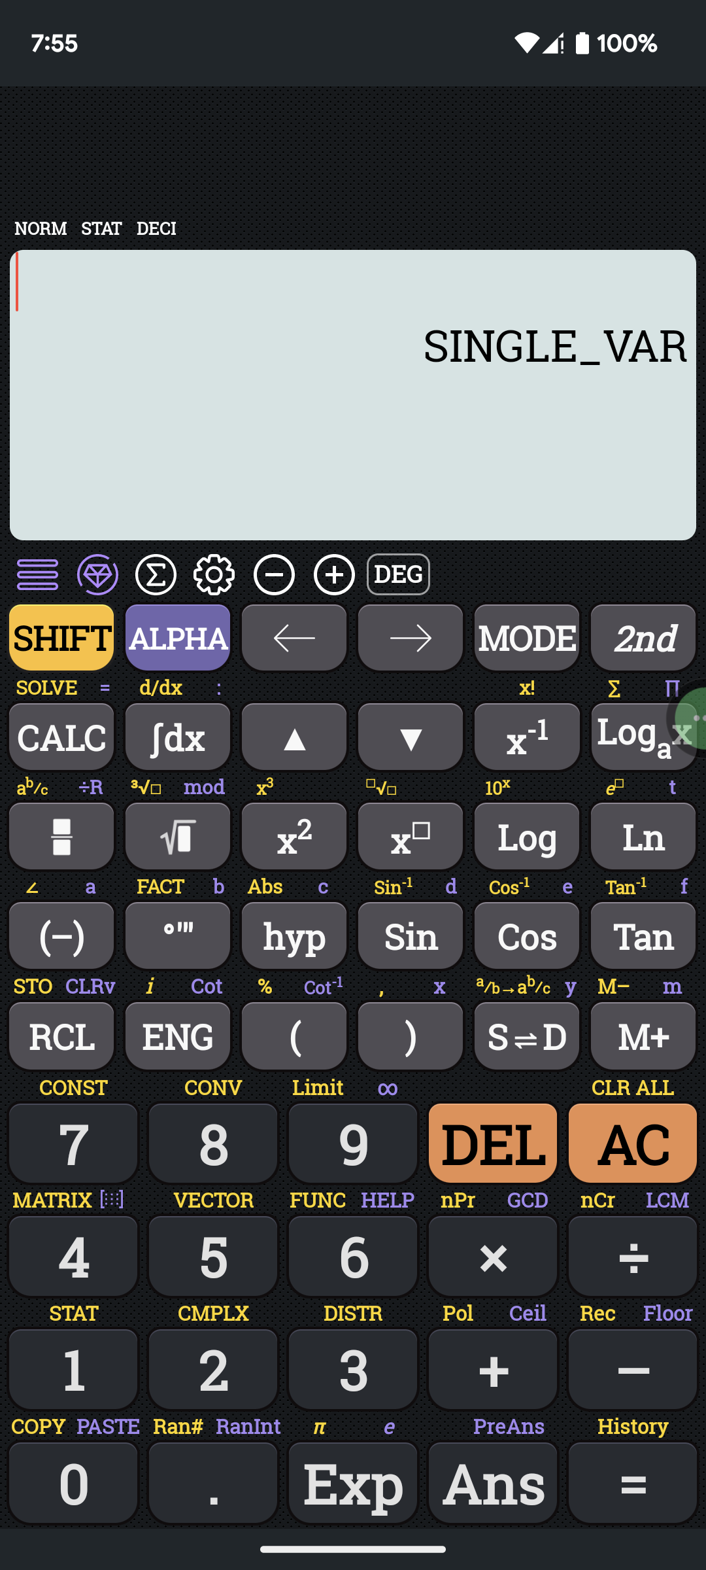
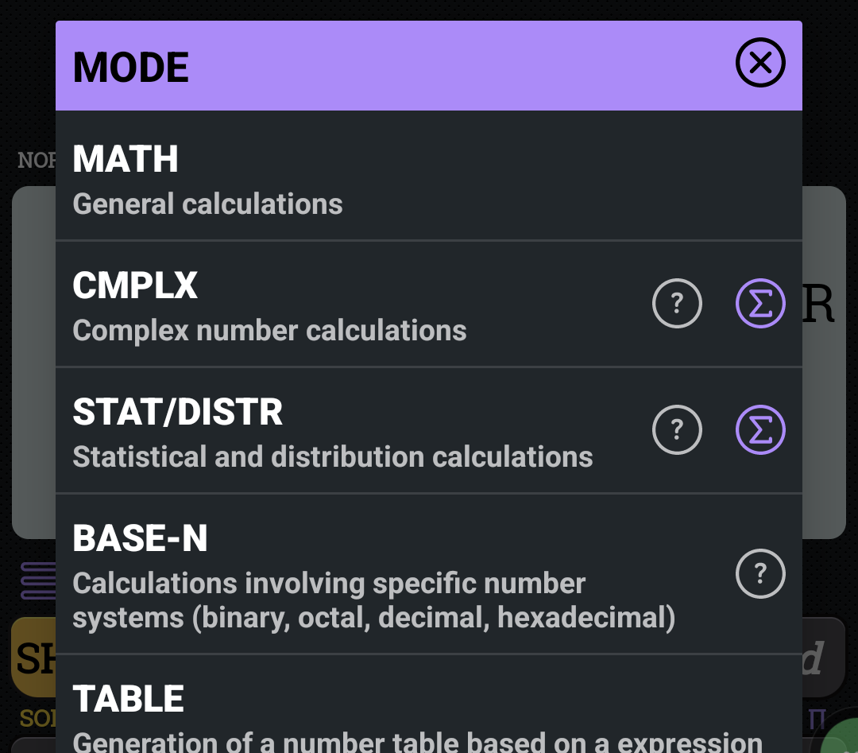
Calculator

Slide 17
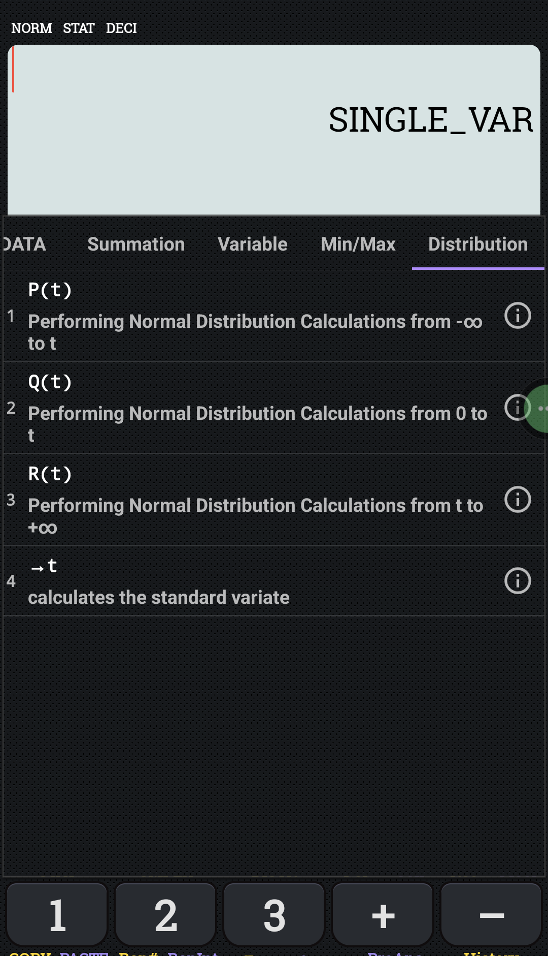
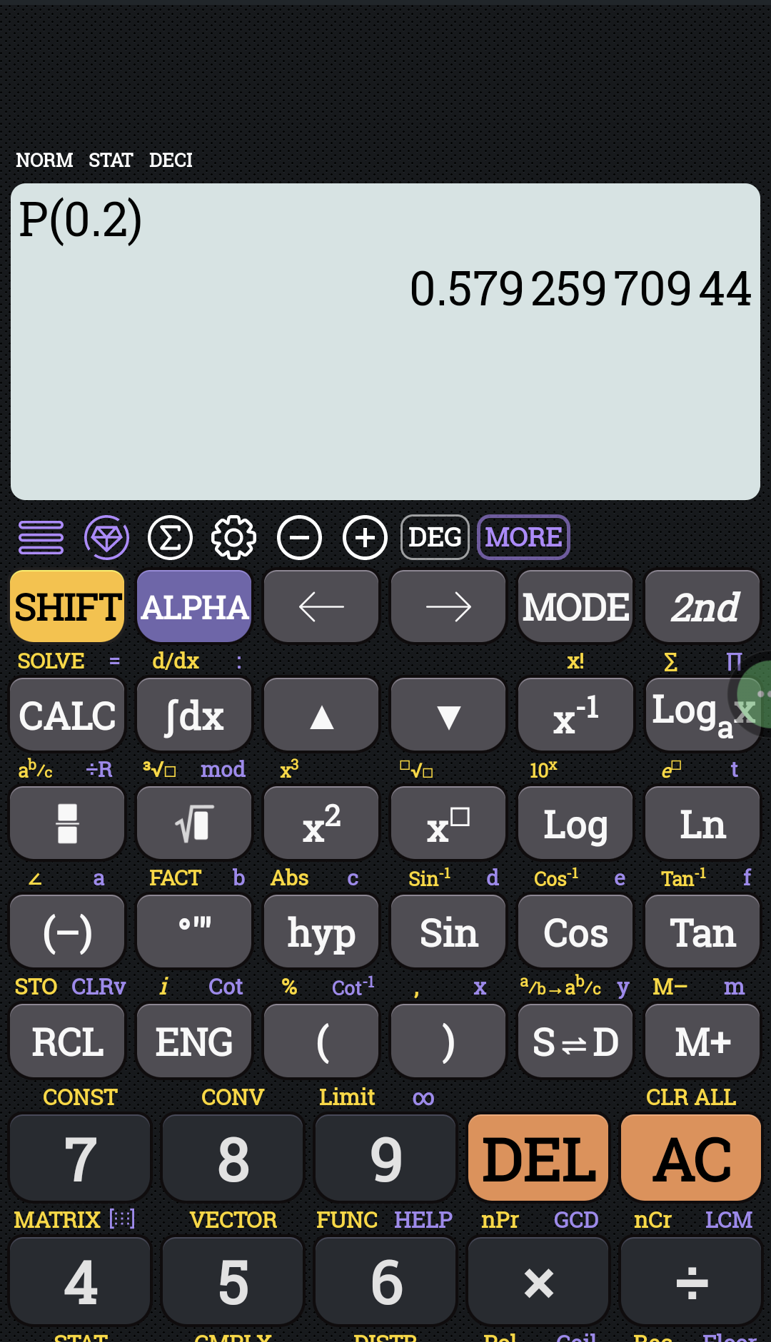
Calculator

Slide 18


Video tutorial
CASIO 991 ES
CASIO 991 EX

Slide 19
Example
Transform the probability statement in terms of $Z$
$$Z=\left(\frac{X−μ}{σ}\right)$$
Let, $X$= Number of viewers of the show per week (in million)
Here, $X\sim N\left(μ,σ^{2}\right)$
a. Have between 30 and 34 million viewers?
$$P\left(\frac{30−μ}{σ}≤\frac{X−μ}{σ}≤\frac{34−μ}{σ}\right)$$
$$P\left(\frac{30−μ}{σ}≤Z≤\frac{34−μ}{σ}\right)$$
$$P(30≤X≤34)$$
$$P\left(\frac{30−29}{5}≤Z≤\frac{34−29}{5}\right)$$
$$P\left(\frac{30−29}{5}≤Z≤\frac{34−29}{5}\right)$$
$$0.8431−0.5793$$
$$P\left(1\right)−P(0.2)$$
$$P\left(0.2≤Z≤1\right)$$
$$0.262$$

Slide 20

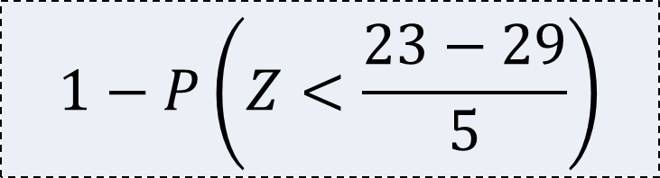

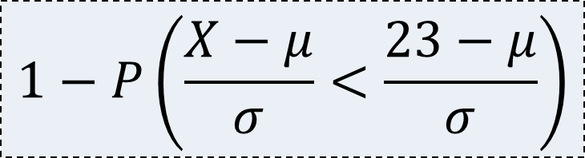




Example
Transform the probability statement in terms of $Z$
$$Z=\left(\frac{X−μ}{σ}\right)$$
b. Have at least 23 million viewers?
$$1−P\left(\frac{X−μ}{σ}<\frac{23−μ}{σ}\right)$$
$$P(X≥23)$$
$$1−P(X<23)$$
$$1−P\left(Z<\frac{23−29}{5}\right)$$
$$0.8849$$
$$1−0.1151$$
$$1−P\left(−1.2\right)$$
$$1−P\left(Z<−1.2\right)$$

Slide 21


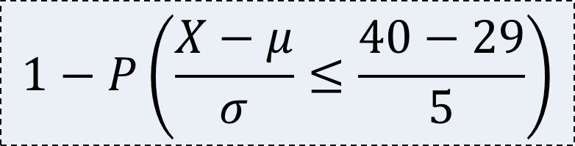



Normal Distribution
Transform the probability statement in terms of $Z$
$$Z=\left(\frac{X−μ}{σ}\right)$$
c. Exceed 40 million viewers?
$$1−P\left(\frac{X−μ}{σ}≤\frac{40−29}{5}\right)$$
$$P(X>40)$$
$$1−P(X≤40)$$
$$1−P\left(Z≤2.2\right)$$
$$1−P\left(2.2\right)$$
$$0.0139$$

Slide 22
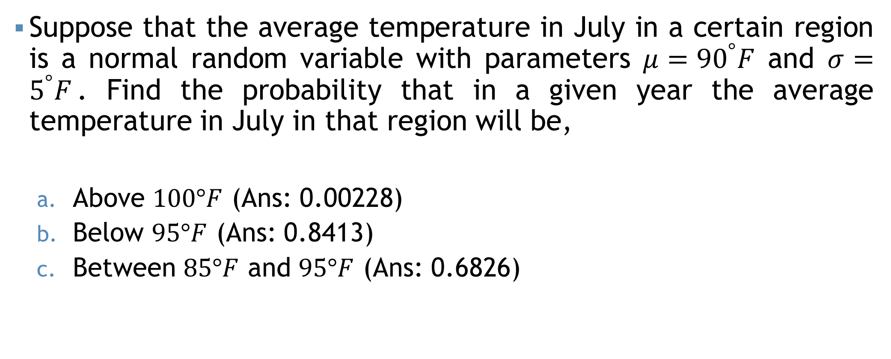
Example
Suppose that the average temperature in July in a certain region is a normal random variable with parameters $μ={90}^{°}F$ and $σ=5^{°}F$. Find the probability that in a given year the average temperature in July in that region will be,
Above $100°F$ (Ans: 0.00228)
Below $95°F$ (Ans: 0.8413)
Between $85°F$ and $95°F$ (Ans: 0.6826)

Slide 23
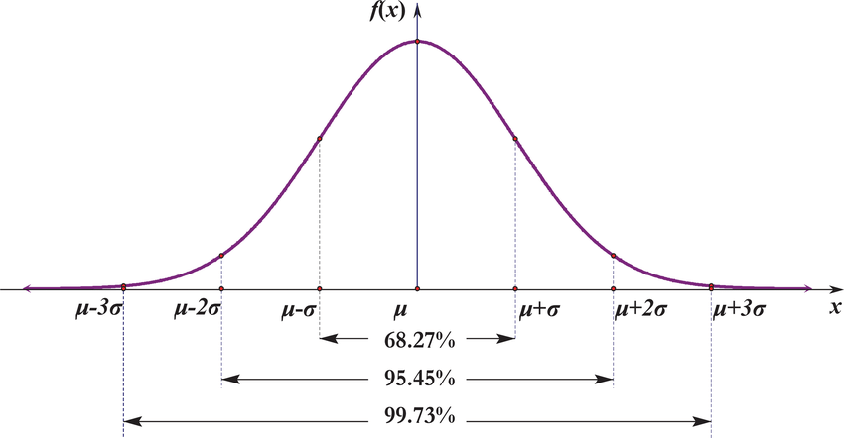





3$σ$ Rules
$$P\left(μ−σ<X<μ+σ\right)=0.68$$
$$P\left(μ−2σ<X<μ+2σ\right)=0.95$$
$$P\left(30<X<34\right)=0.68$$
$$P\left(μ−3σ<X<μ+3σ\right)=0.99$$

Slide 24

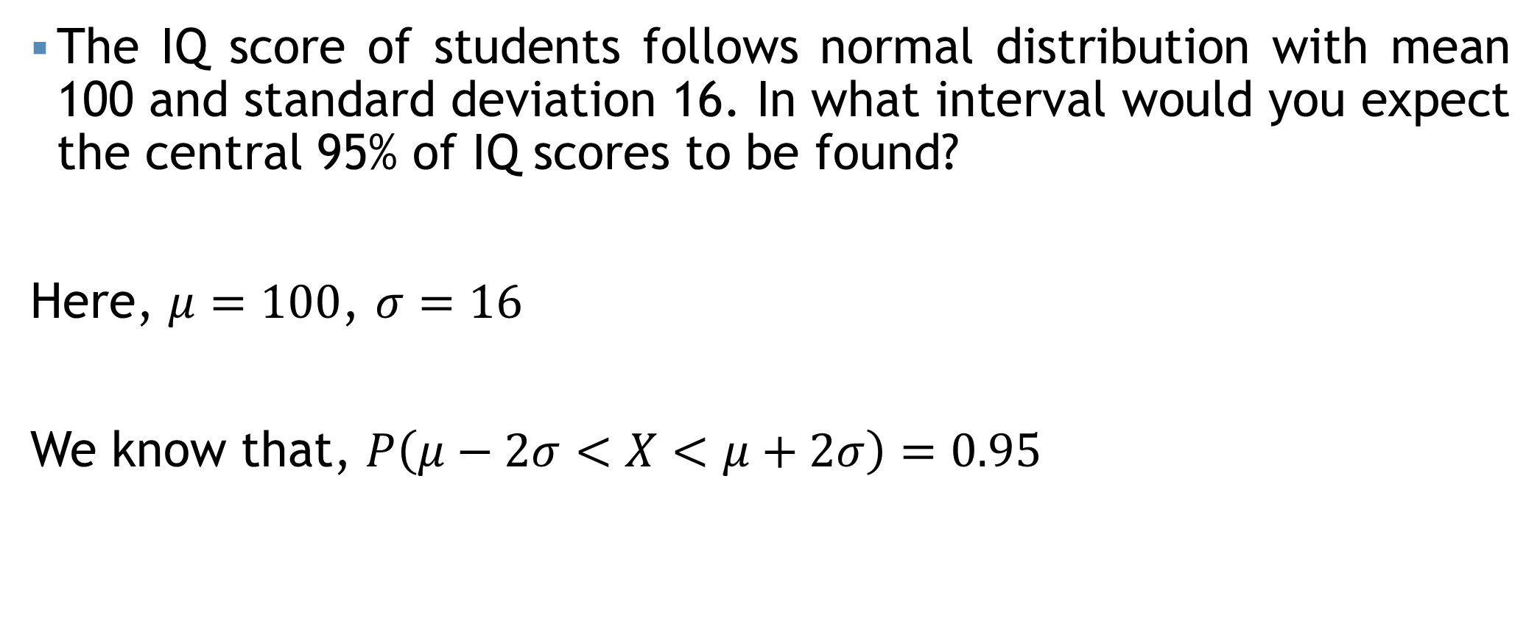

Example
The IQ score of students follows normal distribution with mean 100 and standard deviation 16. In what interval would you expect the central 95% of IQ scores to be found?
Here, $μ=100$, $σ=16$
We know that, $P\left(μ−2σ<X<μ+2σ\right)=0.95$
It is expected that 95% of students have an IQ between 68 and 132
$$μ−2σ=100−\left(2×16\right)=68$$
$$μ+2σ=100+\left(2×16\right)=132$$

Slide 25
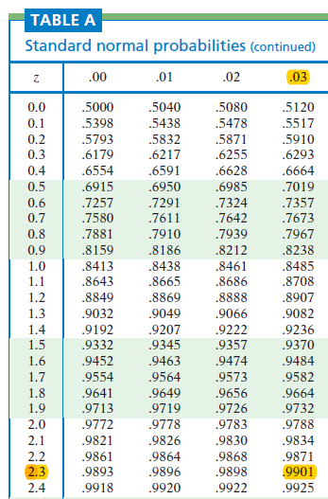


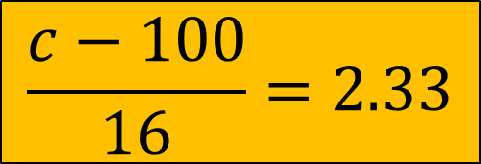
Example
For what value of “c”, $P\left(X>c\right)=0.01$
$P\left(\frac{X−μ}{σ}>\frac{c−100}{16}\right)=0.01$
$P\left(Z>\frac{c−100}{16}\right)=0.01$
$1−P\left(Z≤\frac{c−100}{16}\right)=0.01$
$P\left(Z≤\frac{c−100}{16}\right)=0.99$
$P\left(Z≤2.33\right)=0.99$
$$\frac{c−100}{16}=2.33$$
$$c=???$$

Slide 26
Self Practice
A company pays its employees and average wage of $5.25 per hour with a standard deviation of 60 cents. If the wages are approximately normally distributed,
What percentage of the employees receive wages between $4.75 and $5.69 per hour?
Calculate the lowest cut off wages value for 10% employees.

Slide 27
Mathematical exercise
To access additional mathematical problems, please refer to the PDF lecture notes.

Slide 28
Thank You

